Slide 1
Deep Learning using Python
By Dr. Ali Saeed

Slide 2
Steps to implement deep learning algorithm
Connect with Google Drive
Read Dataset
Model develop
Model Test

Slide 3
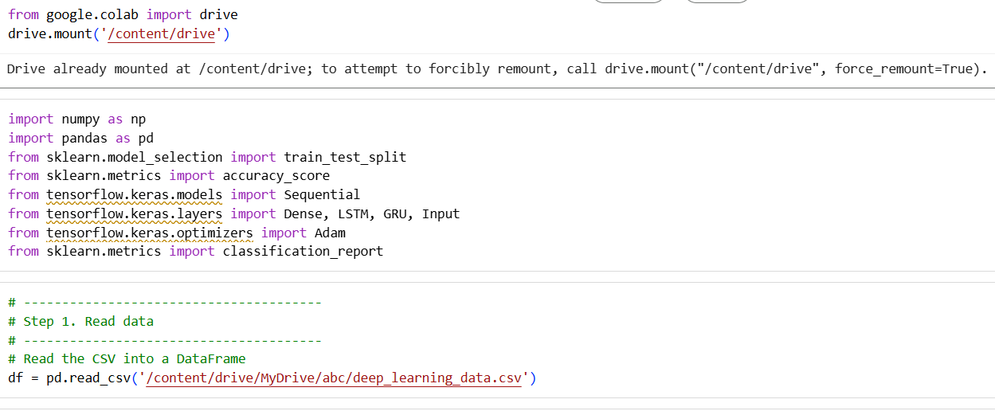
Connect with Google Drive

Slide 4
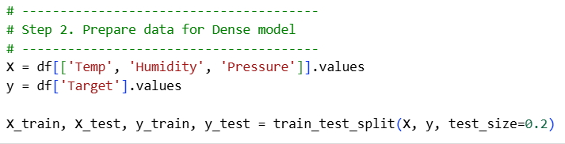
Read Dataset

Slide 5
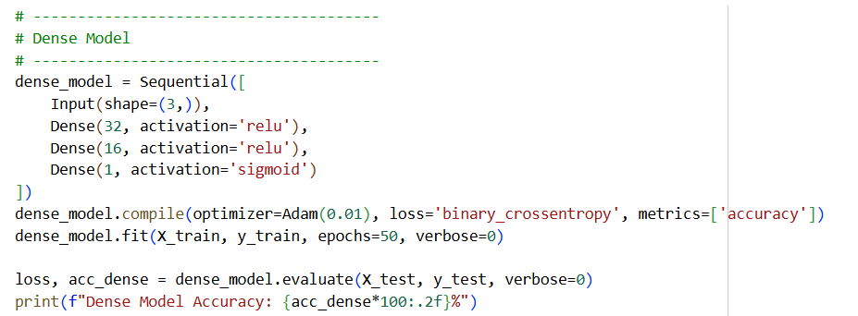
Model Development

Slide 6
Model Development Key Terms
Sequential
Activation
Dense
Optimizer
Loss
metrics
verbose

Slide 7

Sequential - a linear stack of layers

Slide 8
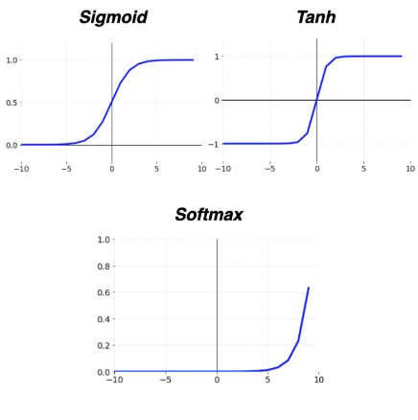
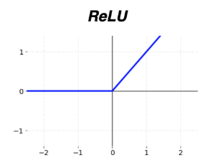
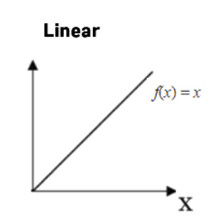
Activation Function
An activation function is a mathematical operation applied to a neuron’s output in a neural network.
It decides whether a neuron should be activated or not — in other words, it introduces non-linearity into the model.
Examples:

Slide 9
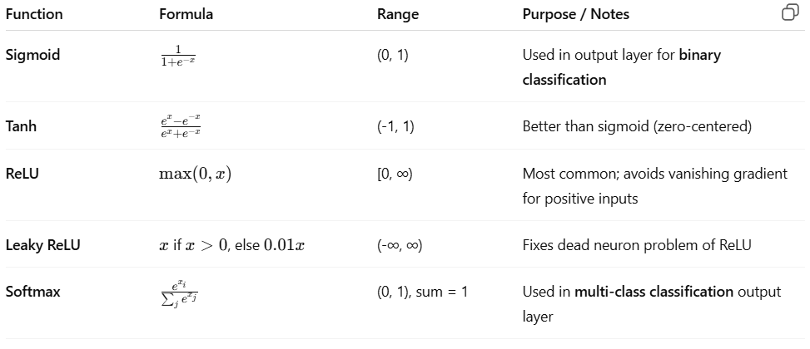
Formulas for various Activation Functions

Slide 10
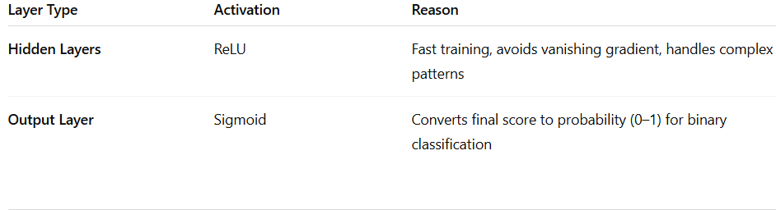
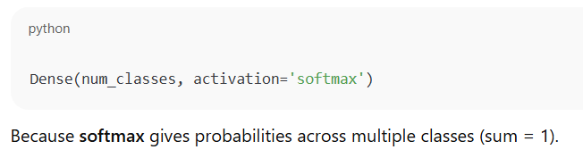
Why we use ReLU on hidden and sigmoid on output layer?

Slide 11
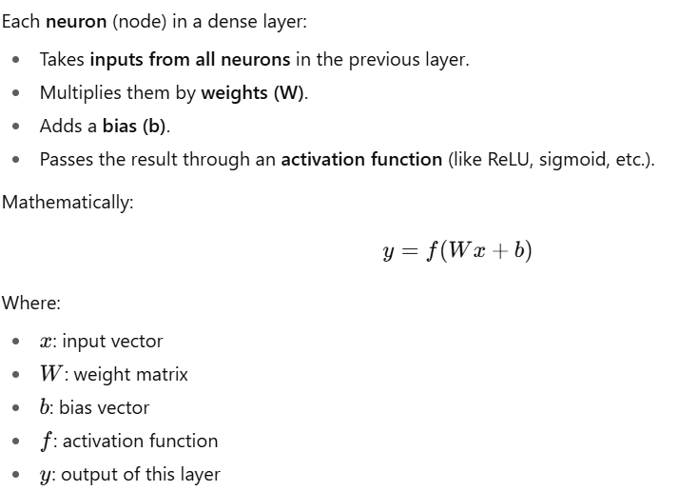
Dense Layer
In Keras, Dense represents a fully connected (FC) layer — also called a dense layer in deep learning.

Slide 12
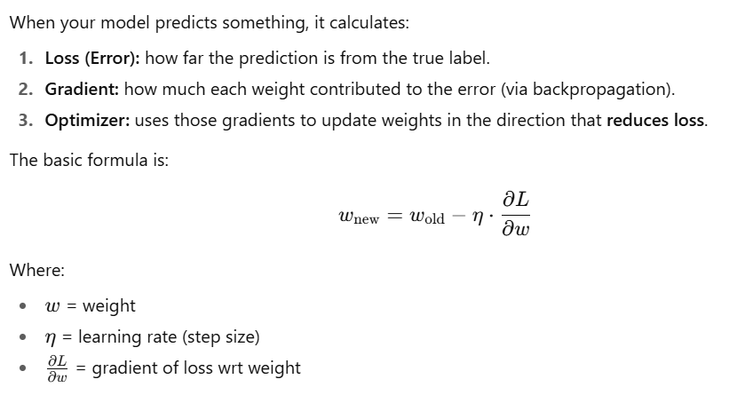
Optimizer in deep learning
An optimizer in deep learning is an algorithm that updates the weights of your neural network during training so that the model learns to minimize its loss function (error).

Slide 13
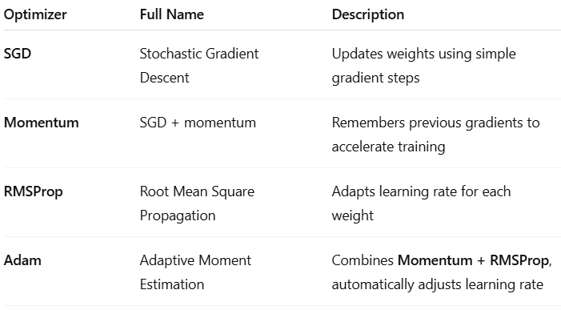
Common Optimizer examples use in deep learning

Slide 14
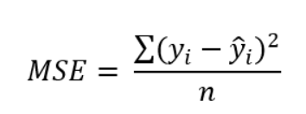
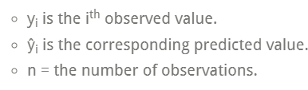
Loss Function
A loss function is a measure of how good your prediction model does in terms of being able to predict the expected outcome
Loss function also known as cost function and an error function
Error between output and target value
Root Mean Square (Mean Square Error/Quadratic Loss/L2 Loss)

Slide 15
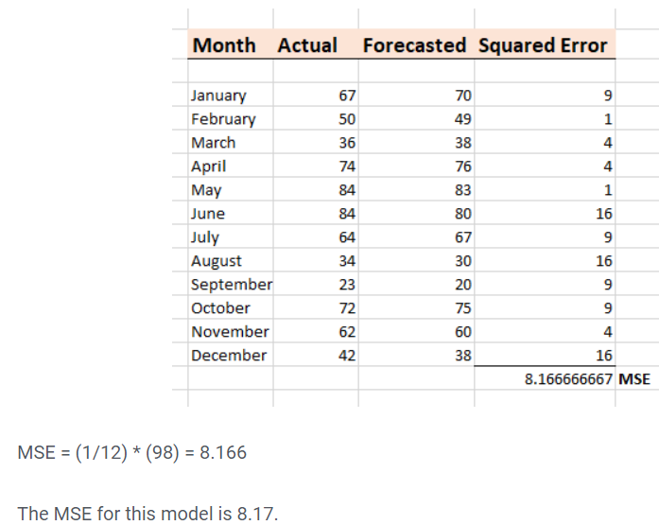
Loss Function Example

Slide 16
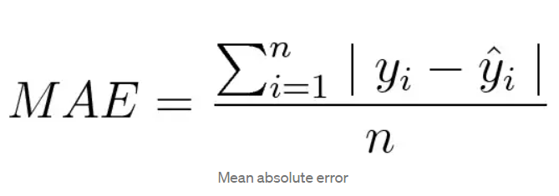
Loss Function
Mean Absolute Error/L1 Loss

Slide 17
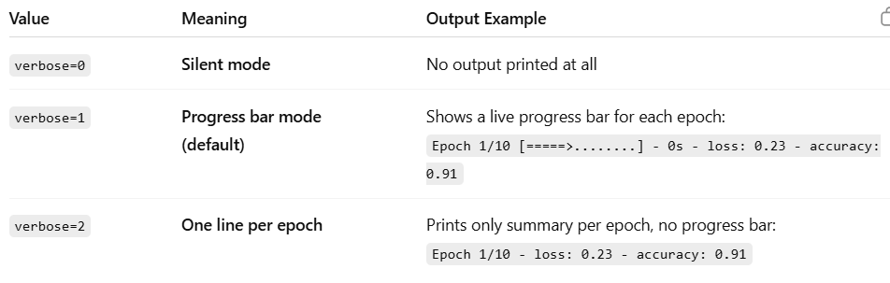
Verbose property in Keras – use in deep learning
The word “verbose” literally means “wordy” or “detailed” —
in programming, it controls how much information is displayed while your code runs.

Slide 18
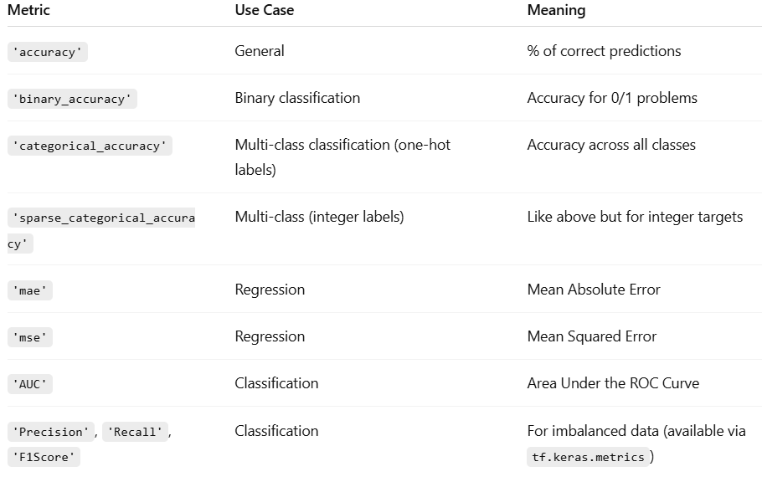
Metric in keras
In Keras, the metrics argument tells the model what performance measures to calculate and display during training and evaluation — in addition to the loss.

Slide 19
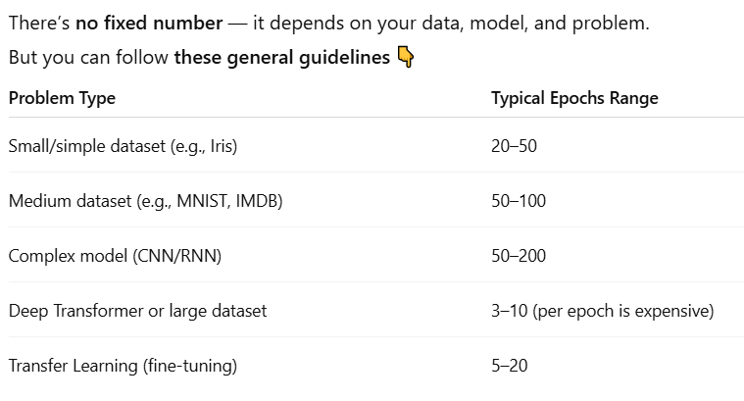
Epochs in Deep learning
An epoch means one complete pass of the entire training dataset through the neural network.
So when you train a model, it goes through your dataset multiple times, adjusting its weights each time to reduce the loss.

Slide 20
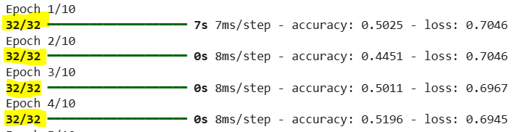
Batch Size – this term is related to eposhs
Batch size = the number of training samples the model processes before updating its weights once. (in a single epoch)
Example:
  Total samples in dataset: 400
  Train / Test Split: 320 / 80
  If I use Batch Size of 10 with 10 epochs, following will be the output:

Slide 21
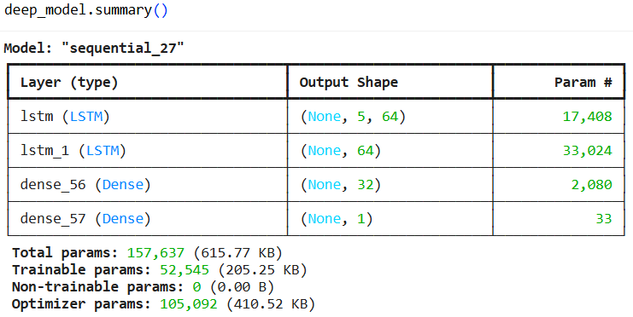
Some useful functions of Keras (model.summary)

Slide 22
Save Model

Slide 23

Load Model

